Slide 1

BANK
MANAGEMENT
SYSTEM
COMPUTER SCIENCE (083) PROJECT 2022-23
PREPARED BY : Rupanjan Bhattacharyya, Sandipan Pal, Samadrita Jalal, Sanjana Samanta, Shailey Barai

Slide 2




INTRODUCTION
The Bank Account Management System is an application for maintaining a person's account in a bank. In this project I tried to show the working of a banking account system and cover the basic functionality of a Bank Account Management System. To develop a project for solving financial applications of a customer in banking environment in order to nurture the needs of an end banking user by providing various ways to perform banking tasks.
A computer based management system is designed to handle all the primary information required to calculate monthly statements of customer account which include monthly statement of any month. Separate database is maintained to handle all the details required for the correct statement calculation and generation.
This project intends to introduce more user friendliness in the various activities such as record updation, maintenance, and searching. The searching of record has been made quite simple as all the details of the customer can be obtained by simply keying in the identification or account number of that customer. Similarly, record maintenance and updation can also be accomplished by using the account number with all the details being automatically generated. These details are also being promptly automatically updated in the master file thus keeping the record absolutely up-to-date.

Slide 3


FEATURES OF THE SOURCE CODE
TKINTER MODULE FOR GUI
The tkinter package (“Tk interface”) is the standard Python interface to the Tcl/Tk GUI toolkit. We have used import* statement to import all names into the current calling module.
1
TK ARCHITECHTURE
We have used tk architecture in our source code, tk is a tcl package implemented in c that adds custom commands to create and manipulate gui widgets. Which can be customized easily.
2

Slide 4

FRAMEWORK OF THE SOURCE CODE
The current-value setting of some widgets are connected directly to application variables by coupling the widget variables. The utility command, WM, is used for interacting with the window manager. The bind method from the widget command has allowed to watch for certain events and to have a callback function trigger when that event type occurs.
3
DATABASE APPLICATION PROGRAMMING INTERFACE
MySQL Connector enables Python programs to access MySQL databases, using an API that is compliant to communicate with the operating system and Python Database API which is implemented by calling functions in the programs that provide linkage to the required program a task.
4
PROGRAMME SPECIFIC ELEMENTS
Required number of widgets are added to the main window. User defined functions are used for the purpose of applying the event trigger on the widgets.
5

Slide 5
LOGIC AND FUNTIONALITY OF THE PROGRAM
To Log in -
First the user must log in to their mysql account by giving the appropriate password and username.
Click log in button.
This will open the management page in which all the records and details are stored.
For Creating a new Account –
Enter first name, last name ,id , address , mobile number in their respective entry boxes.
If you want a account with 0 balance the keep the withdraw and deposit entrys empty
If you want to create a account with a certain amount of money already in there then type that amount in the deposit entry box.
After all the above steps are complete click on the add record button to create your account .
For Updating the values of your records-
Select the record which you want to edit from the list of records.
The entry boxes will fill up with the details you entered when you first created the account. Then you can change the record details .
Click the update record button to apply changes to your selected account.

Slide 6
Advantage 2
Advantage 1
The user can also find a specific account by using the search option on the basis of id which is unique to every account.
This program can be used to view and alter multiple accounts at one time.
UTILITIES OF THE PROGRAM
Advantage 3
Advantage 4
By using the mysql database the account information doesn’t remains stored even after we close the program, moreover mysql database are very secure so there is less chance of date being manipulated by any unwanted user.
The GUI makes it more accessible to people who are not familiar with the workings of mysql and python.

Slide 7
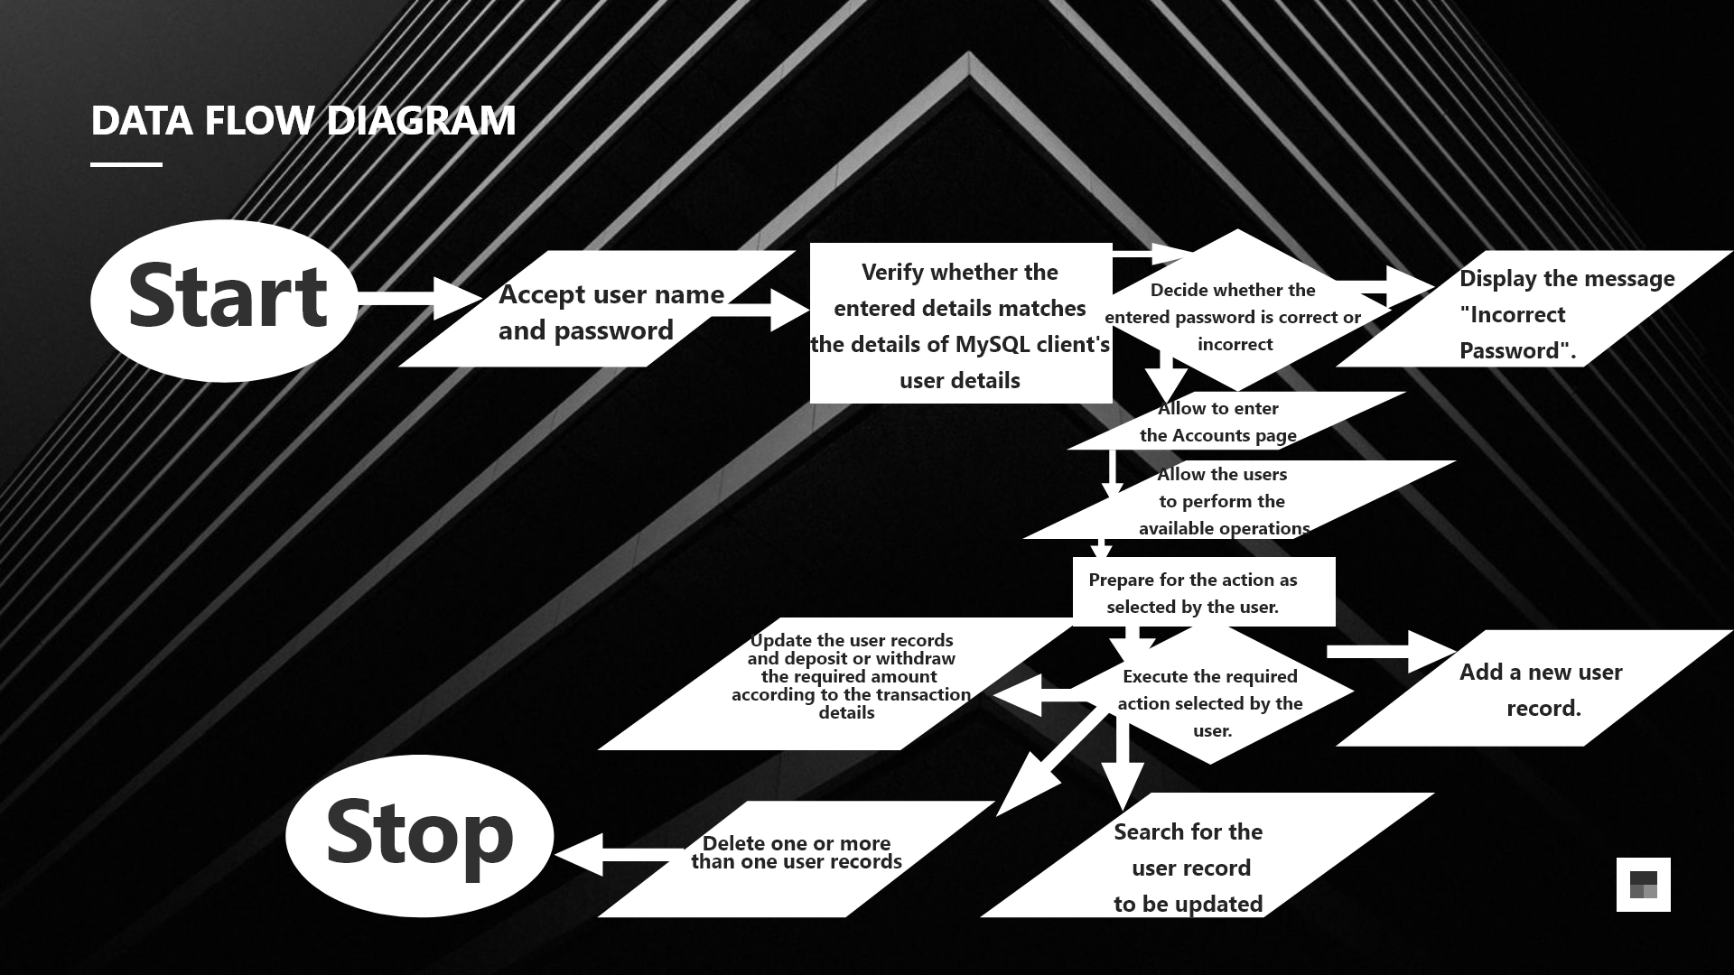

Slide 8
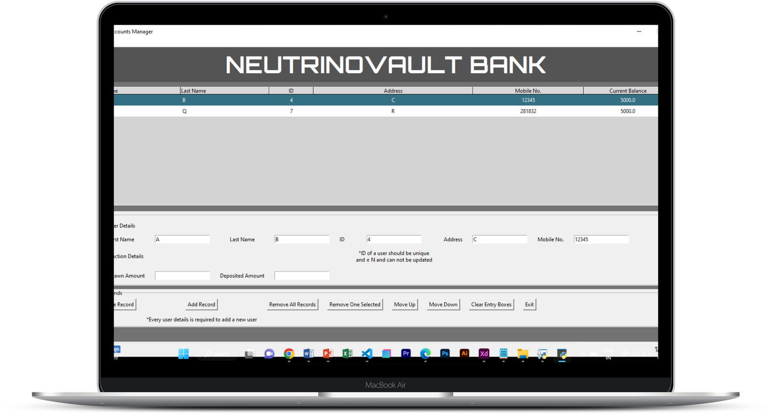
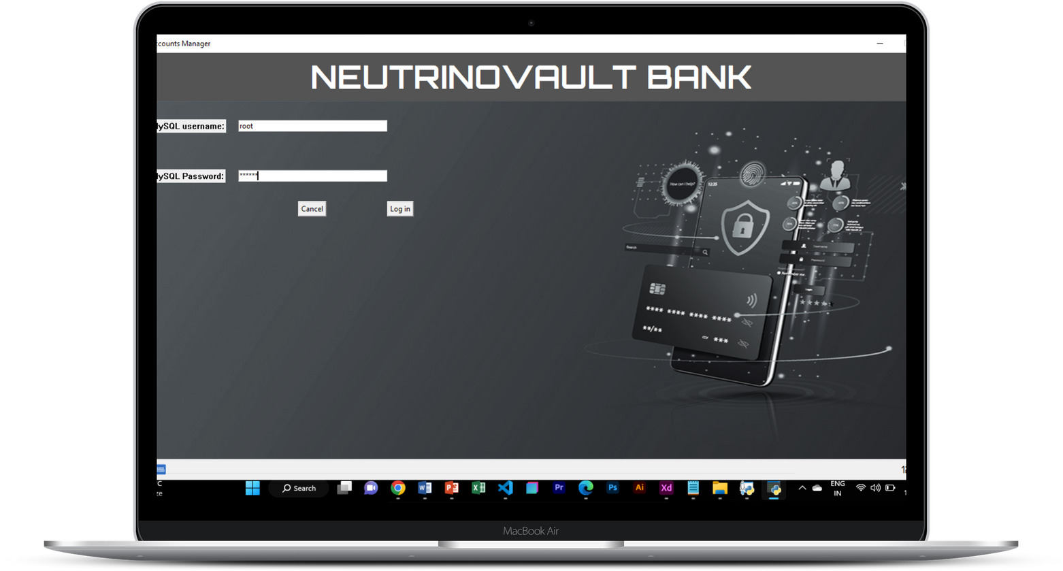

OUTPUTS

Slide 9
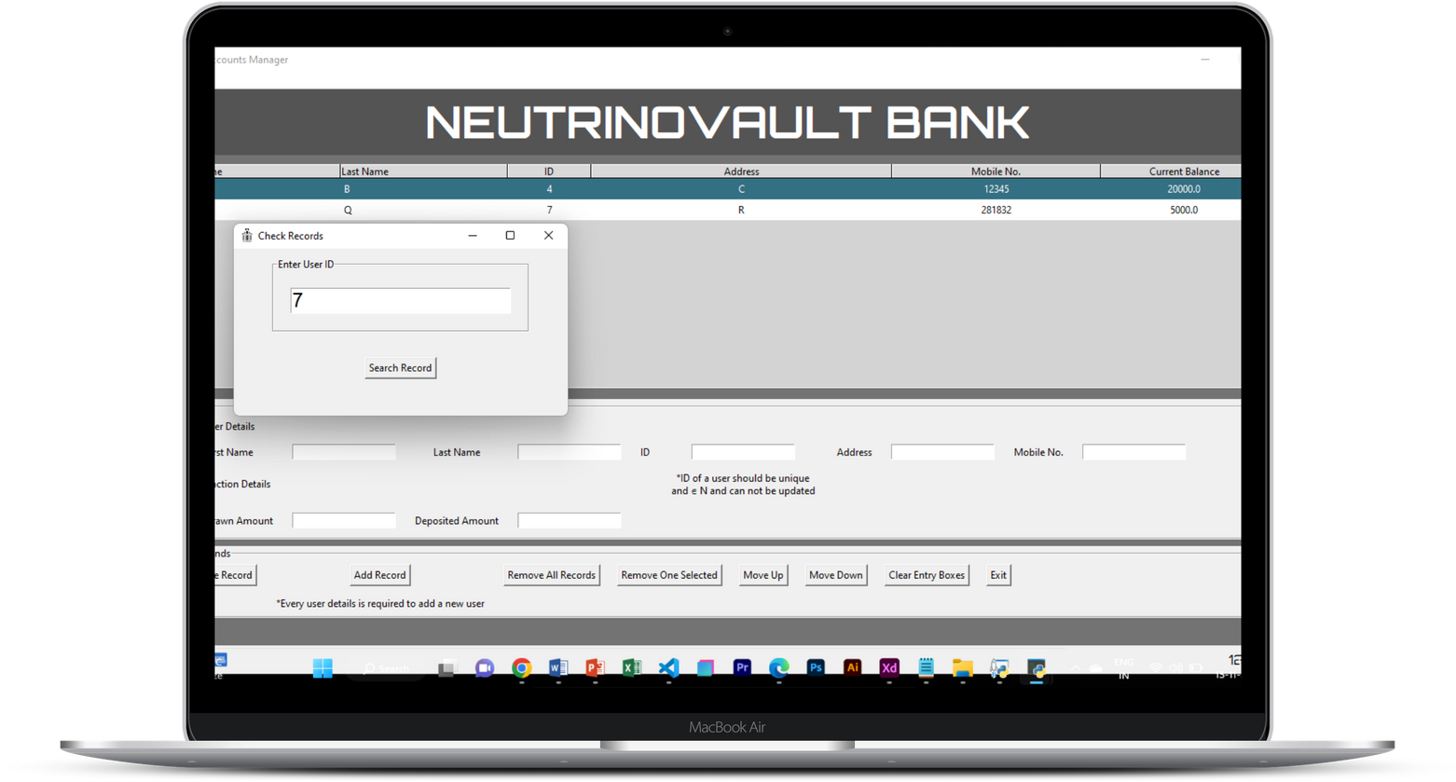

OUTPUTS

Slide 10

Thank You

